Slide 1

Insights that Matter! Encoding Data to Forecast Service Calls
Shiv Kumar Sambasivan
View in Presentation Mode

Slide 2
Outline
Introduction
Key Takeaways
Forecasting Framework – Key Highlights
EDA Insights
Model Forecast

Slide 3





PhD. Mechanical Engineering, 2010
B.S. Mechanical Engineering, 2003
ExxonMobil, 2013 – Present
Los Alamos National Lab, 2010-2013
The University of Iowa, 2004 - 2010
About Me
Computer Science: Python, C, C++, Machine Learning, HPC, CUDA
Technical: Computational Physics, Applied Statistics, Engg. Economics
Leadership: SME, Project Management, Technical Lead, Mentor
Work Highlight: ExxonMobil Investor Day
Outstanding Performance Award: ExxonMobil & LANL
Best Presentation Award: AIAA and UI
Publications: 30
Citations: 700

Slide 4
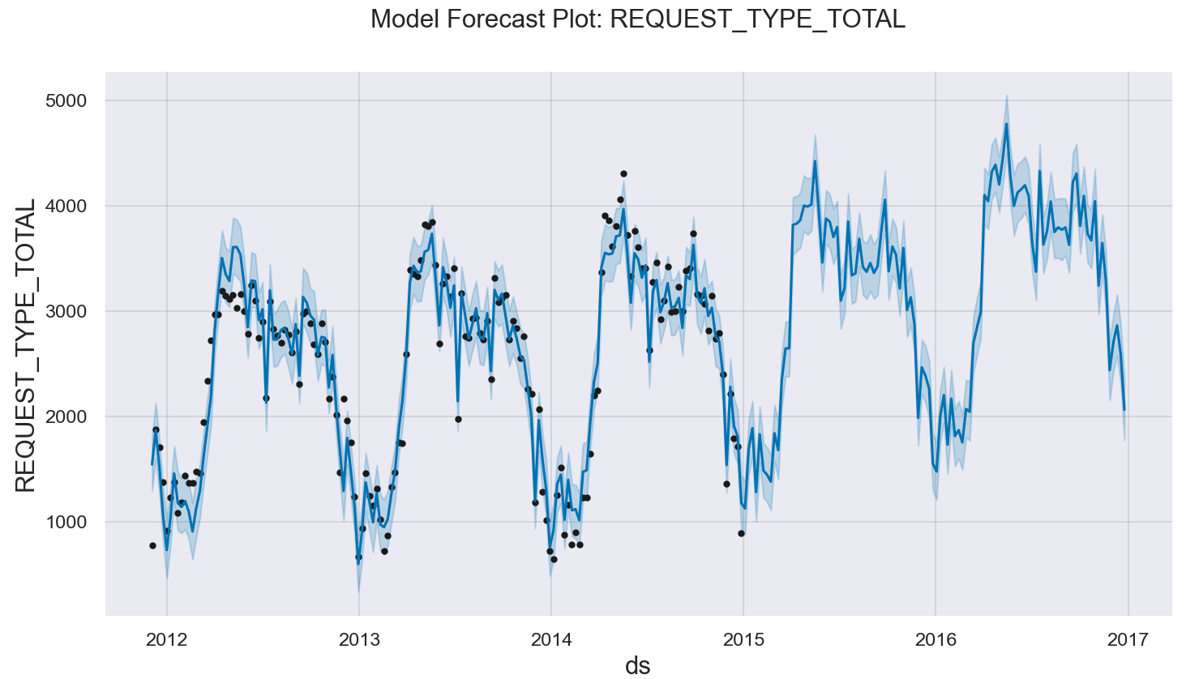
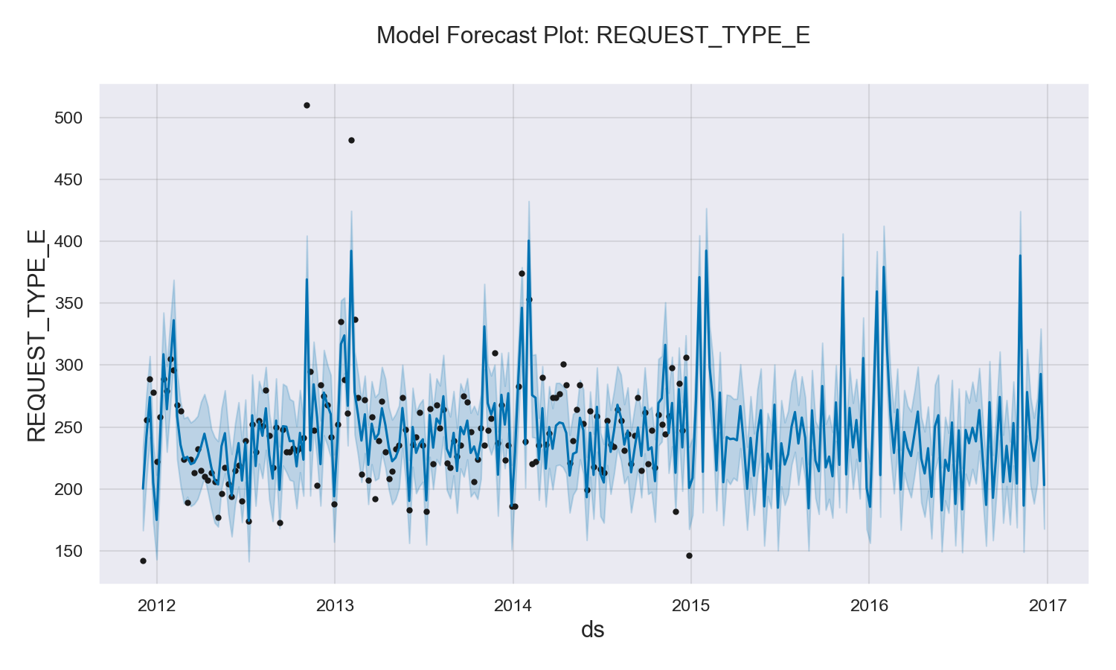
Key Takeaways
Business Question: Forecast emergency call volumes for the next 12Mo. given historical call volumes and service type
Business Impact: Focused capital deployment with decreased response time delivering improved customer service and reduced service disruption*
Approach: Projection from historical normal and emergency call trends, grounded by sound statistical analysis (Time Series and/or Machine Learning); timeline for work effort ~1 week (start to finish)
Key Findings:
Expect continuous, increasing demand with a peak ~5000/week total (emergency + normal) service calls during the summer of 2016
Expect to have constant demand (avg: ~200/week) for emergency call volumes
Emergency call volumes likely to overwhelm the system at the beginning of the year (troughs in the system); these may coincide with seasonal weather patterns (analysis outside scope of current work)
Call volumes dominated by a handful of town – impact of geographical location and weather patterns can be considered as extensions of this work
Key Uncertainties: External influence (outside of call volumes) such as correlation with weather patterns, seasonal/storm events & geographic location not considered. Surge call volumes difficult to predict and can offset prediction.
*Quantify impact via potential $ savings

Slide 5
Forecasting Framework – Key Highlights
Simplified outline for, often iterative, statistical learning approach (refer right flow diagram)
Problem formulation - a critical step and ‘in sync’ with business objective(s)
Multiple solution strategy analyzed to deliver forecasts with uncertainty bounds (CI)
Multivariate Time Series & Machine Learning (ML) formulations explored; later required reformulating problem to supervised learning augmented with feature engineering
Exhaustive EDA to extract underpinning data trends and key insights
Implemented ~2000 lines of structured Object-Oriented Programming in Python
Key Assumptions
Imbalance (normal calls overwhelm total volumes) class distribution with sparse data
Supplied data presumed to be complete and no additional/external variables considered; potential to synchronize geographic coordinates with NOAA observation (future work)
Projection by town deemed challenging given sparse data and timeline
Regression problem with co-dependence of predictors (normal/total and emergency calls)
Aggregated (daily/weekly) projections enabled via regression models
Key takeaways from different steps highlighted in subsequent slides
Problem Formulation
Metrics Definition
Data Wrangling and Ingestion
Identify ML Approach
Exploratory Data Analysis
Model Training, Verification and Validation
Model/Solution Deployment
Decision Space

Slide 6
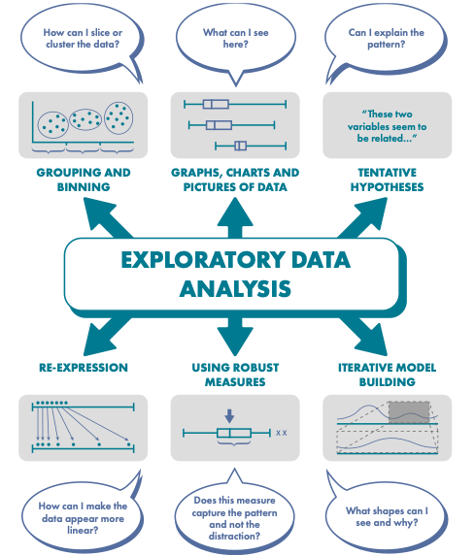
Image Credit: CambridgeMaths

Slide 7
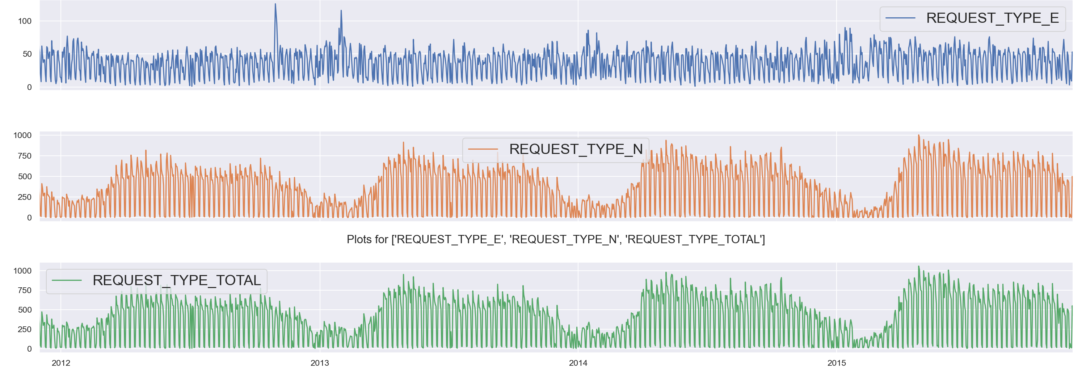
Distribution of Call Volumes over Time
Anomalous peak from data entry or driven by real external factors?
High frequency input data with sparse entry across geographic location
Yearly cyclical trends emerge for normal requests; emergency requests have peaks at the beginning of the year
Nearly constant demand for emergency requests
Both normal and emergency requests have values close to 0 warranting either data clipping or log transformation to prevent undershooting of model forecast; furthermore, log transformation could help with smoothing peaks (performed at the ML step)

Slide 8
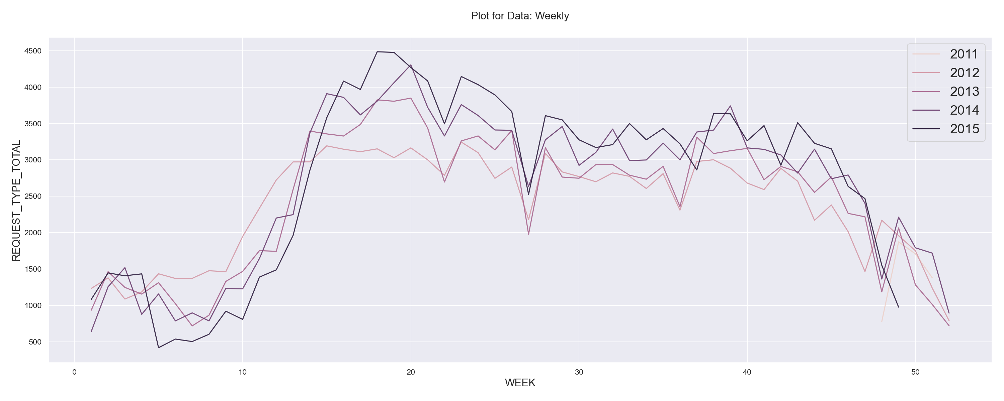
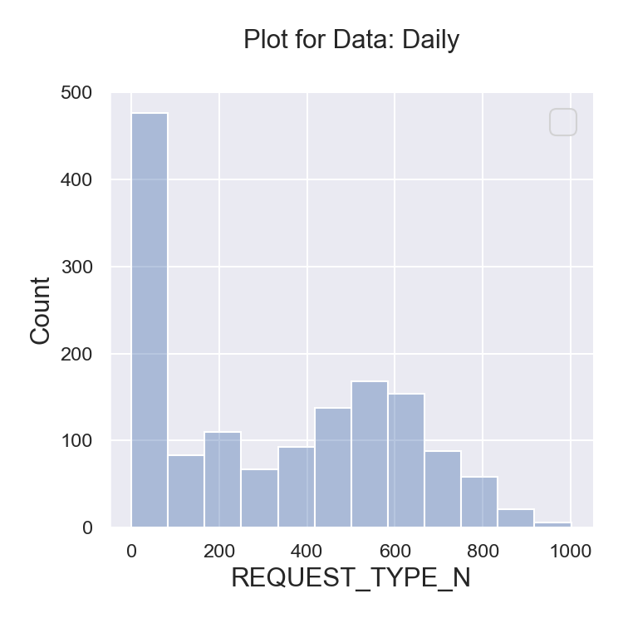
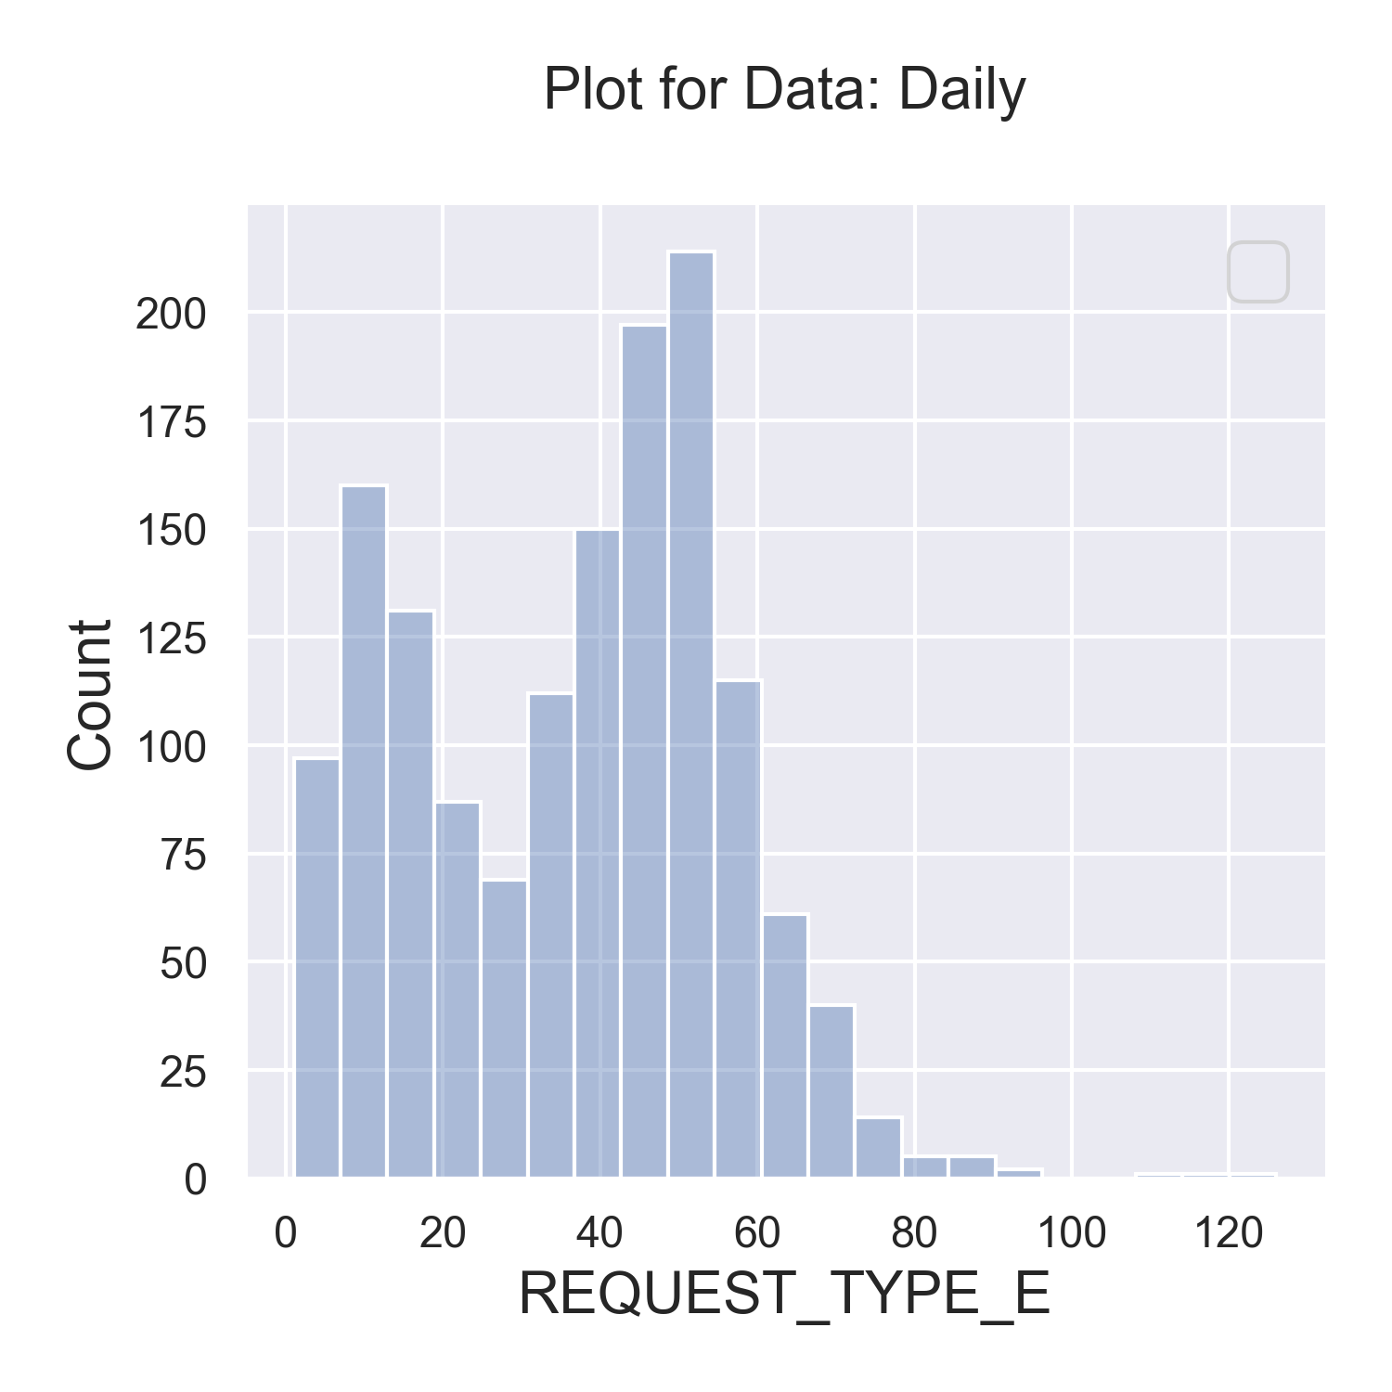
Increasing Volume Observed Year over Year
Up to 25% increase
Weekly frequency further confirm yearly seasonal cycle; increasing demand emerge year over year
Trends appear smoother and amenable for statistical learning techniques
Total distribution for normal requests appear to loosely follows Gaussian
Total distribution for emergency requests display bimodal Gaussian with implications on model accuracy

Slide 9
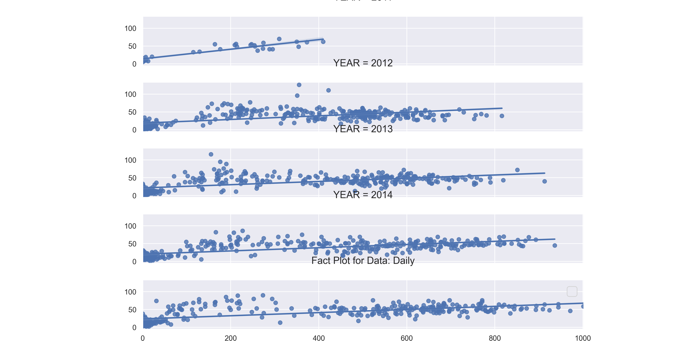
Cross Plot: Normal vs Emergency
Emergency
Normal
Year over year, moderate correlation observed between normal and emergency requests
Evidence of moderate correlation warrants multivariate time series or machine learning models
Overall Pearson’s Correlation Coeff: 0.64

Slide 10
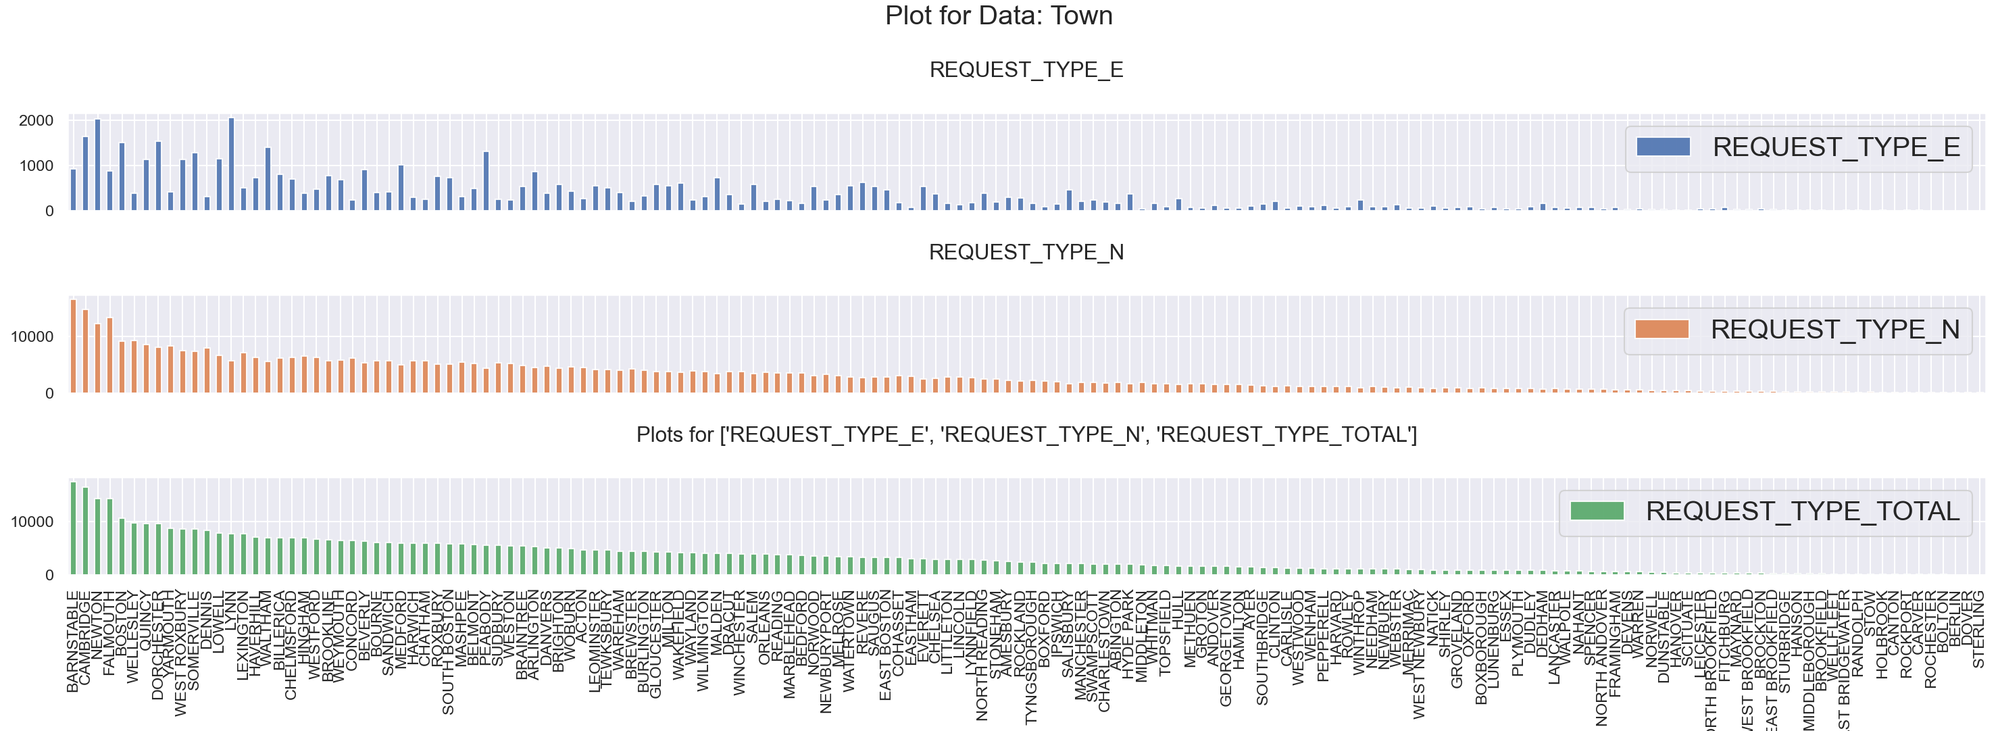
Geographic Dependency on Call Requests
Overall call volumes dominated by ~40% of town
No clear correlation between emergency vs normal requests – highly imbalanced class with sparse data distribution
Recommend focused data collection strategy prioritized by towns that dominate the distribution

Slide 11
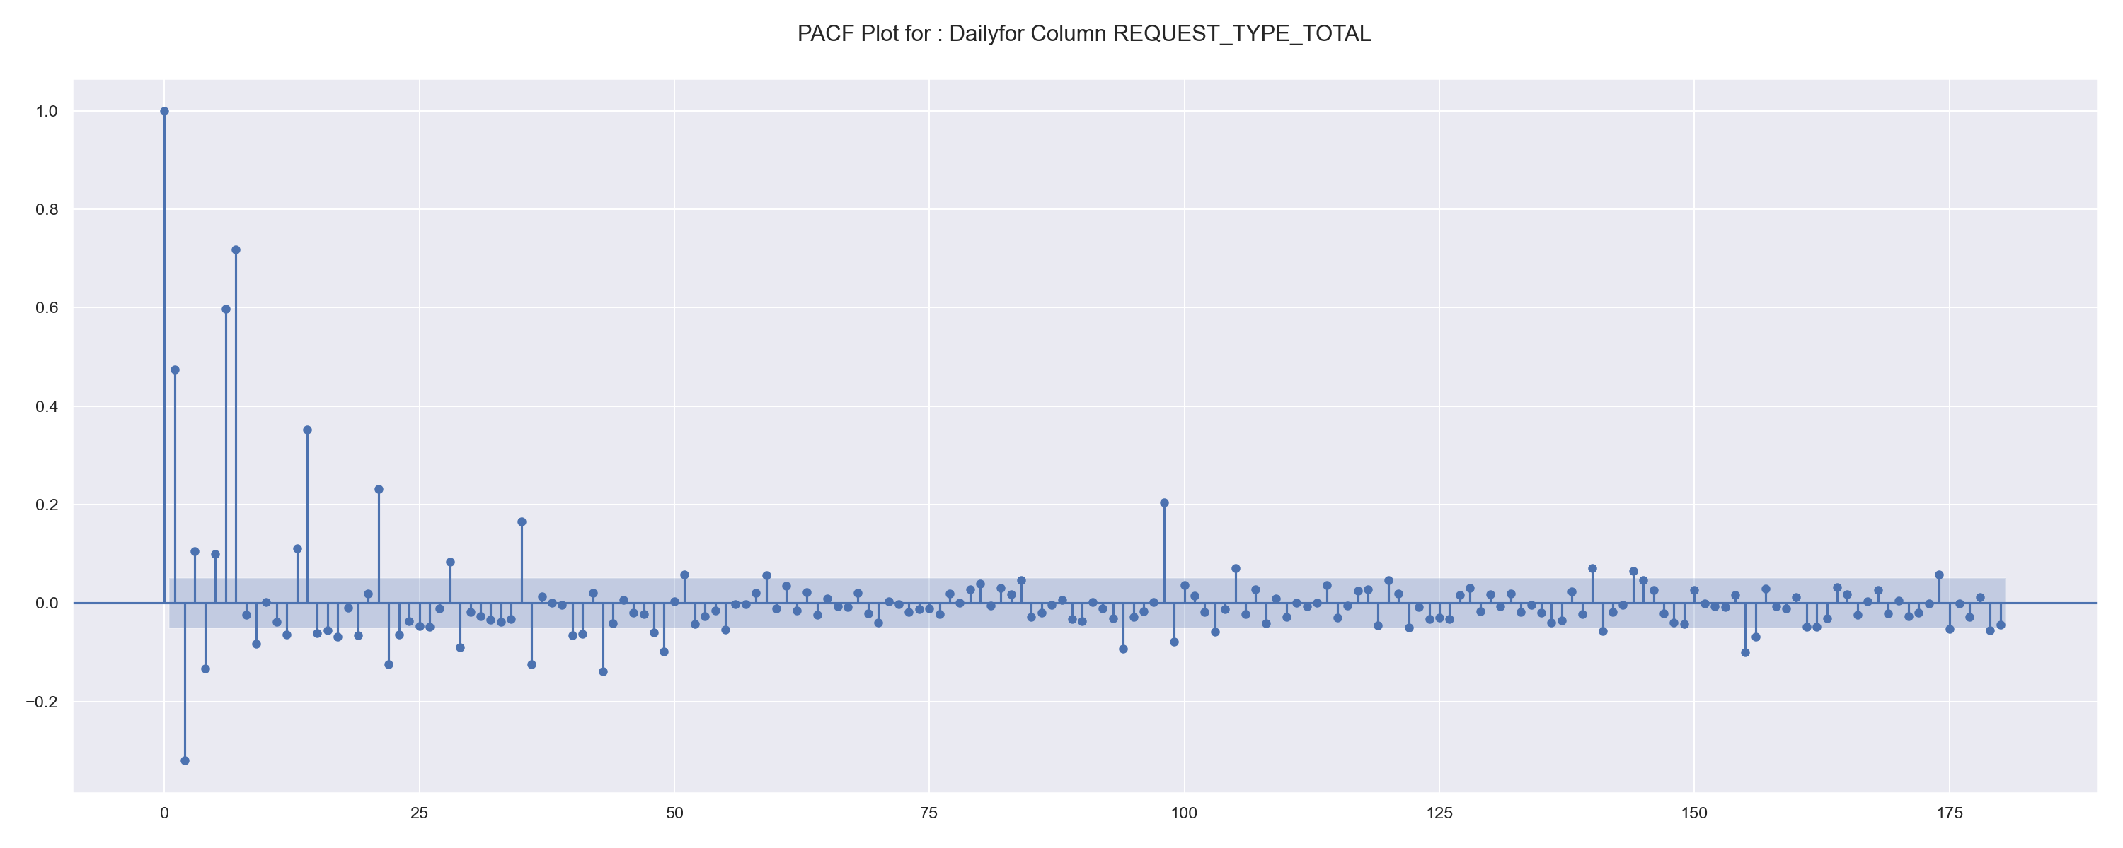
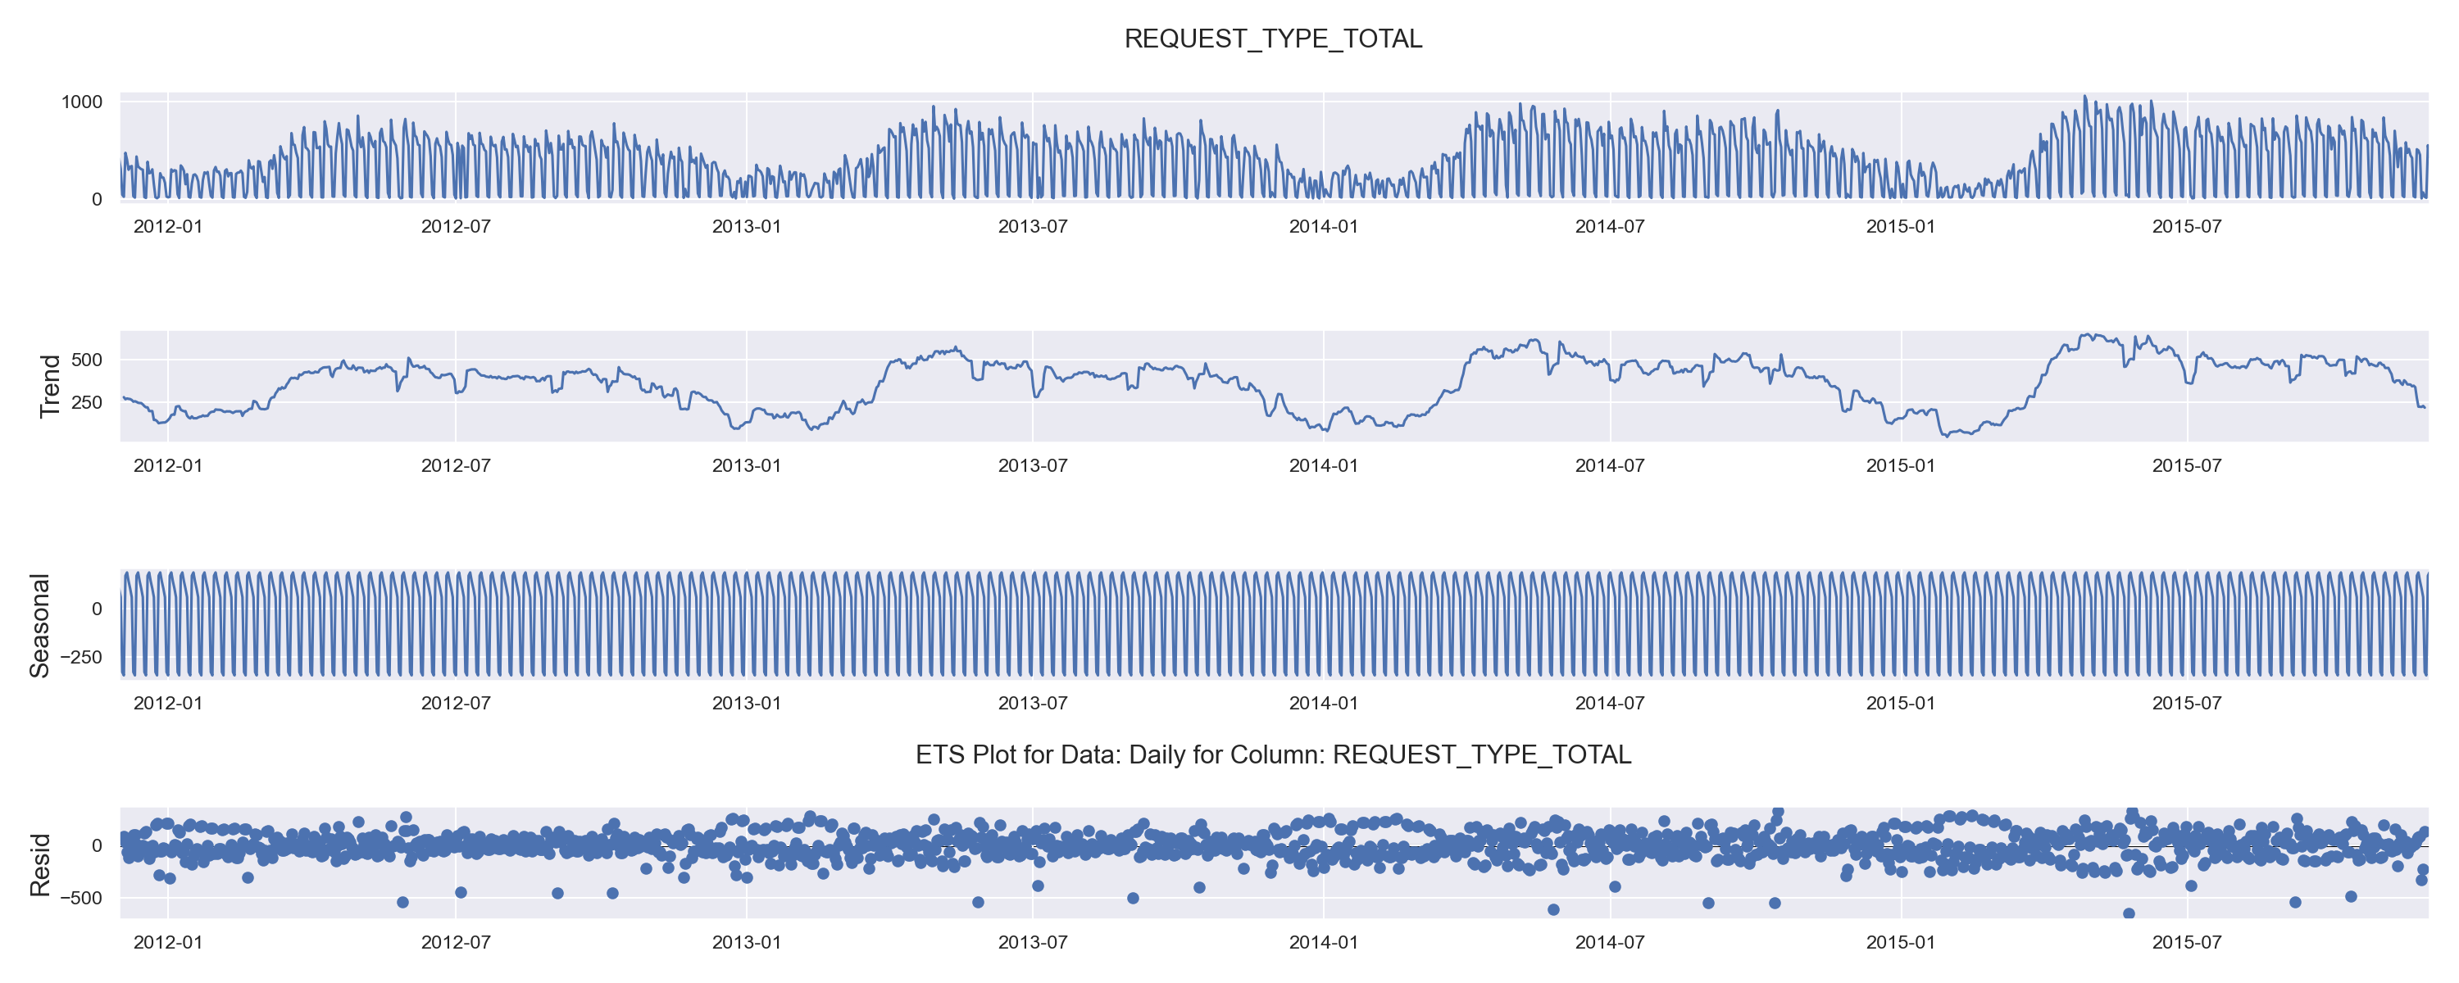
Stationarity & Trend Components
Region below confidence interval
Daily Frequency on Total Requests Show a Period of 2 for Partial ACF
Daily frequency trend is non-stationary
Stationarity can be achieved by sampling on a weekly basis
Models tend to show improved performance with stationary data
ML and time series models (discussed in the next section) show improved fit to weekly forecast
Normal Requests | P Value | Conclusions
Augmented Dickey-Fuller (Daily) | 0.074890 | Ho is True; series is non- stationary
KPSS* (Daily) | 0.0 | Ha is True; series is non-stationary
Augmented Dickey-Fuller (Weekly) | 0 | Ha is True; series is stationary
KPSS* (Weekly) | 0.1 | Ho is True; series is stationary
*Kwiatkowski-Phillips-Schmidt-Shin

Slide 12
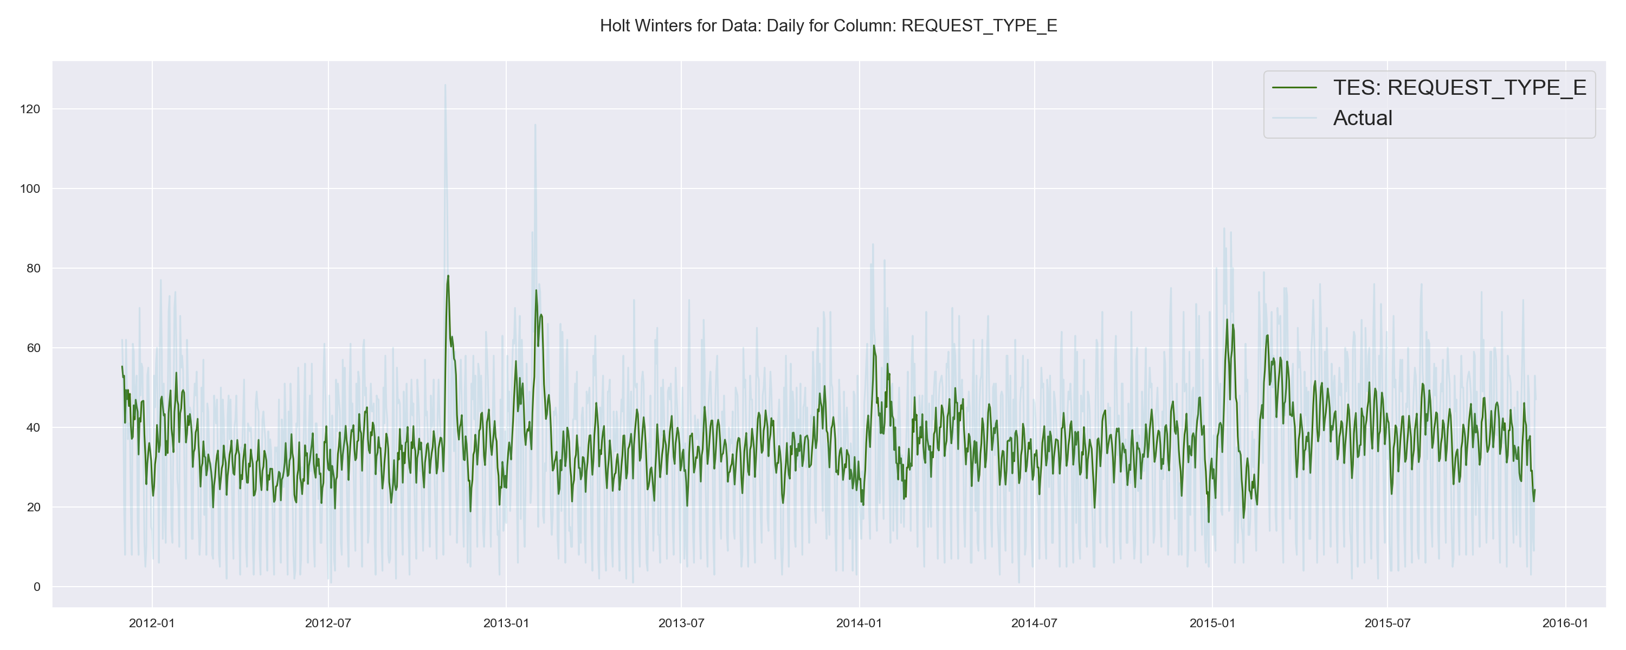
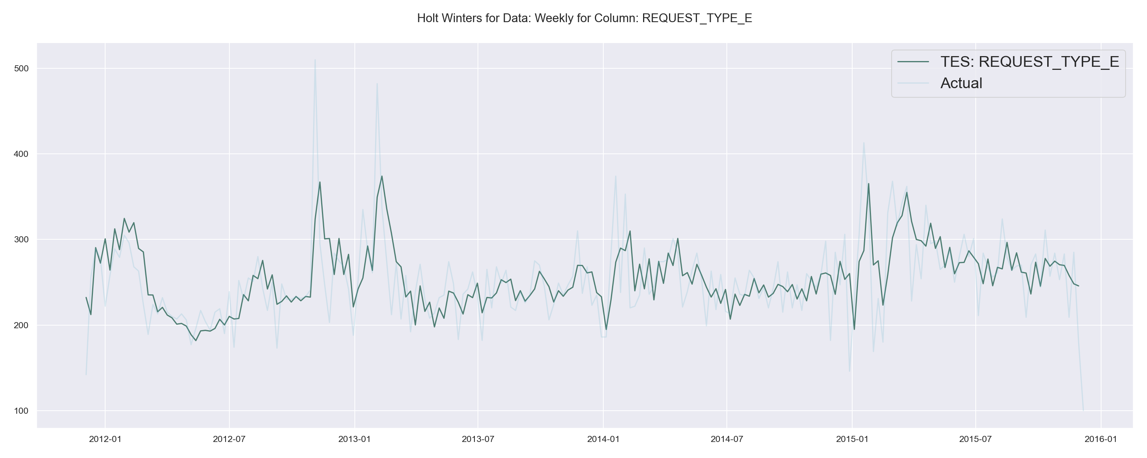
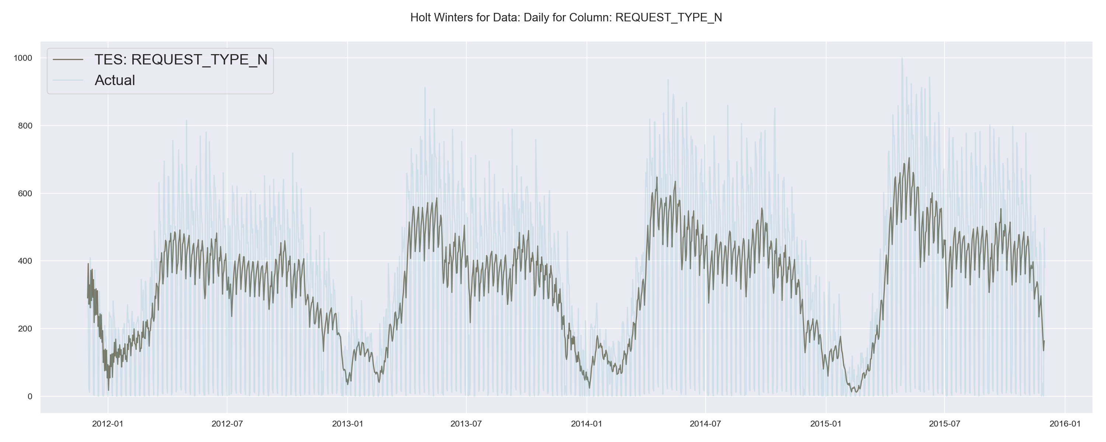
Simple Forecasting Techniques
Reasonable Fit with Holt Winter’s for Daily Freq
Improved Fit with Holt Winter’s for Daily Freq
Simple forecasting techniques such as Holt Winters show reasonable fit to historical emergency service volumes
Fit improved with weekly frequency
Poor fit observed for normal call services; furthermore, correlation between normal and emergency not captured
Robust, comprehensive and multivariate forecasting techniques (discussed in the next section) show promising results
Poor Fit with Holt Winter’s for Daily Freq (N)

Slide 13

Forecasting Framework

Slide 14
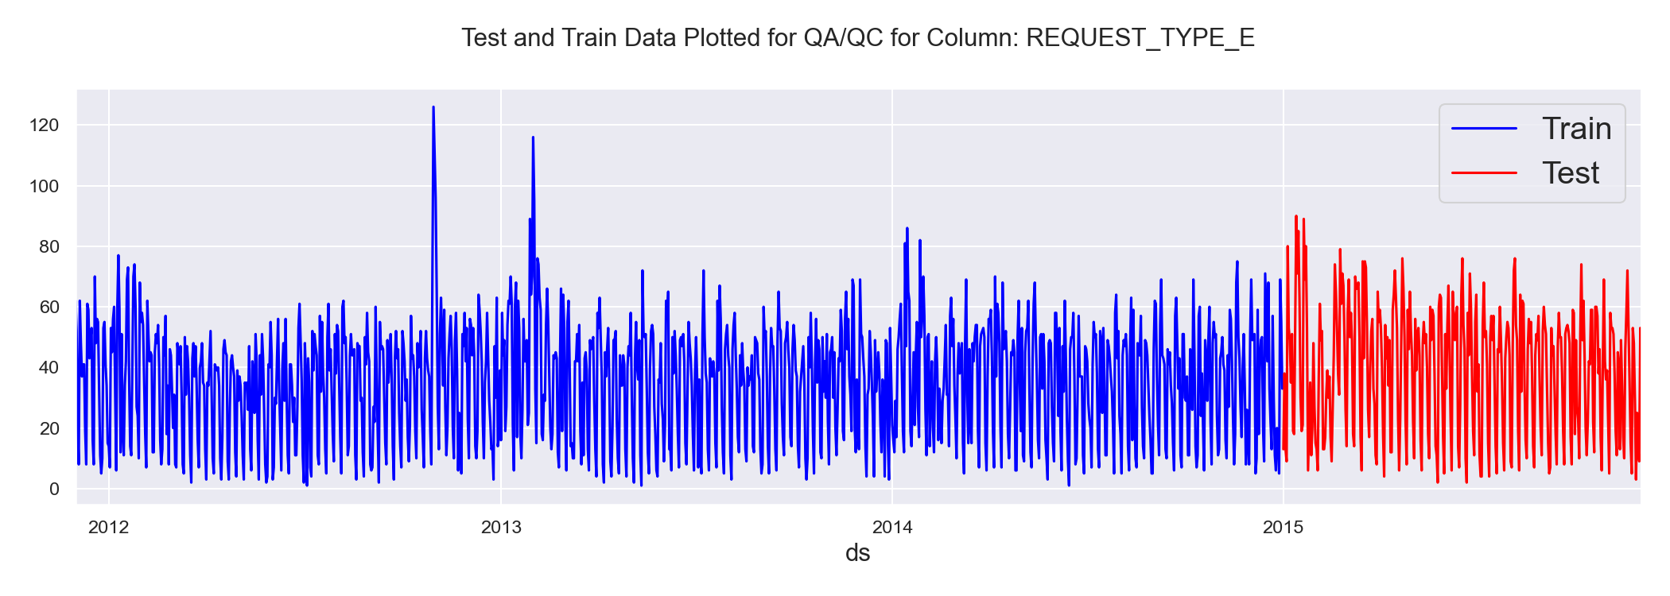
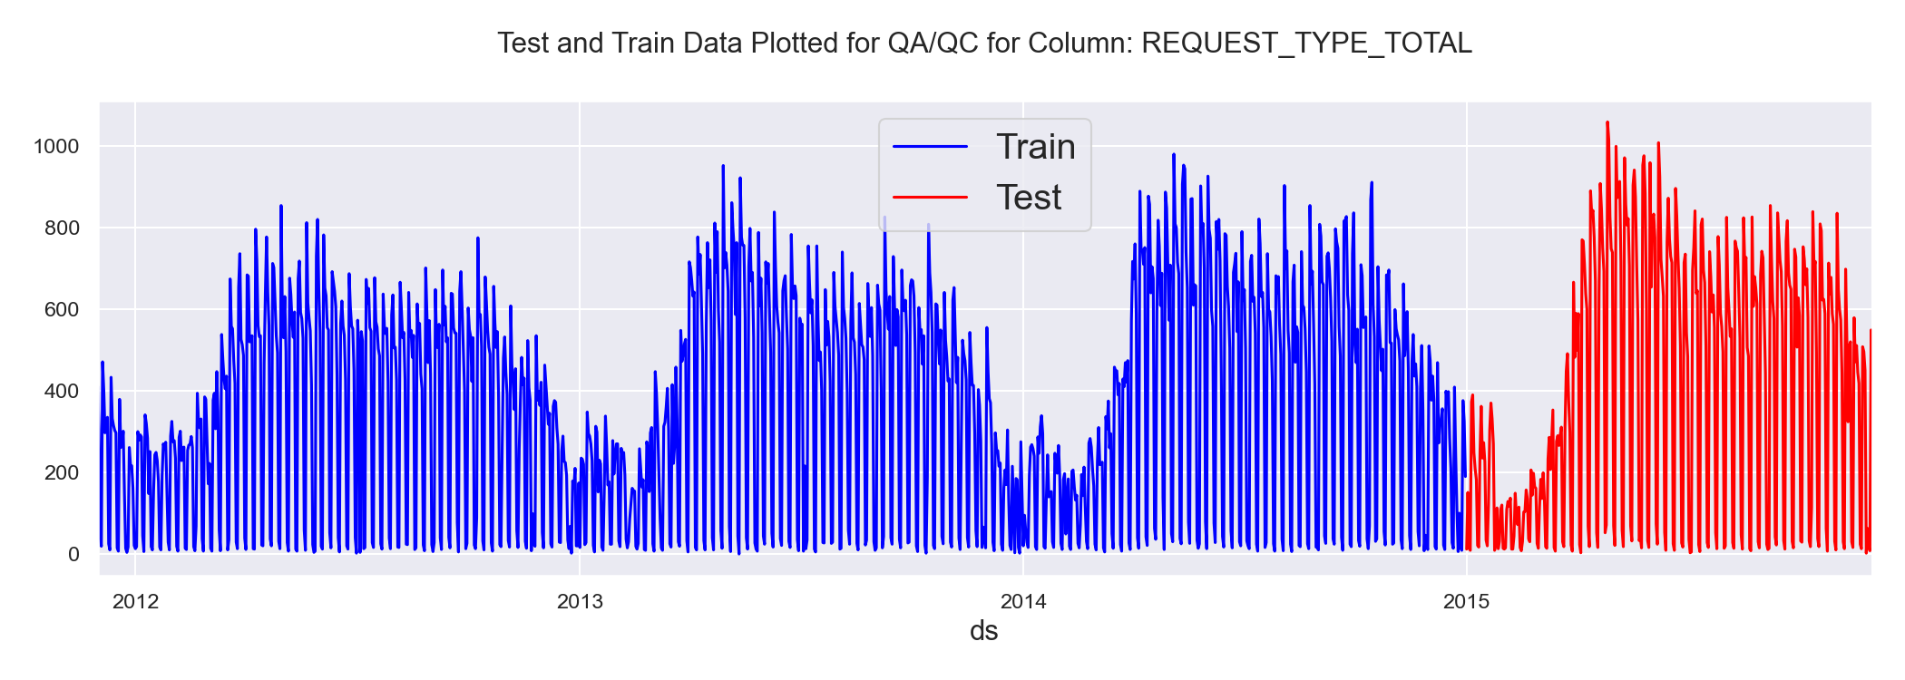
Modeling Framework Overview
Time Series Forecasting Techniques applied in this work:
Facebook’s Prophet with seasonal and regression components (Multivariate forecasting)
Tensorflow based Multivariate RNN implementation
SARIMAX (Univariate)
VAR (Multivariate)
Machine Learning Regression Technique applied in this work:
Multu-output Random Forest regressor (RF)
Prophet and RF yielded the best fit to training and test data (shown in the right); RF yielded poor long-term forecast
Cross validation, hyper-parameter tuning along with model evaluation and custom plotting functions were implemented for each model
Models were evaluated on data with varied frequency intervals
Further tuning can help in increasing model predictability

Slide 15
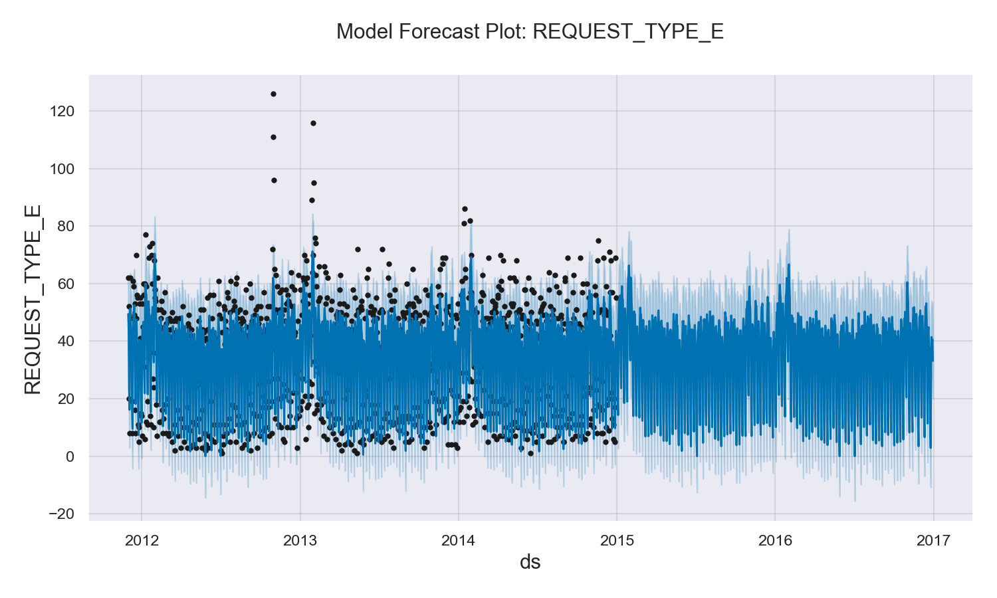
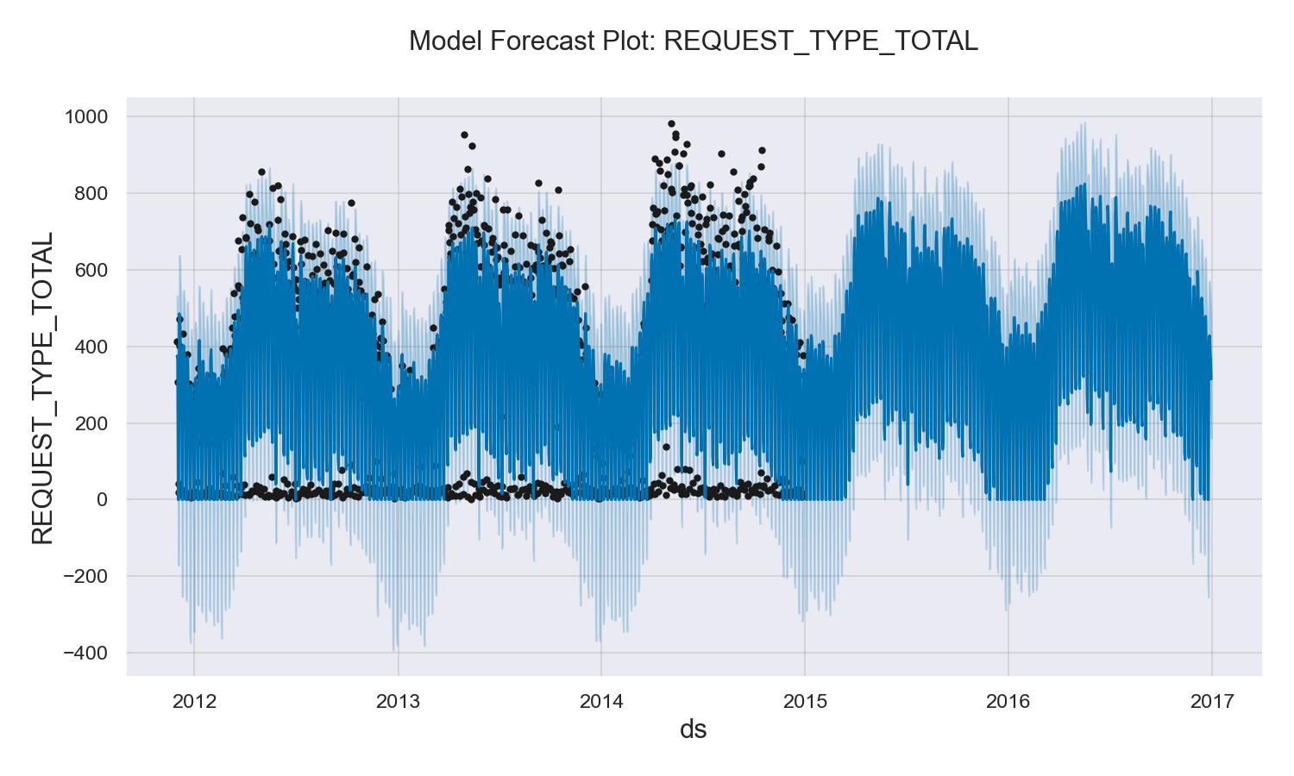
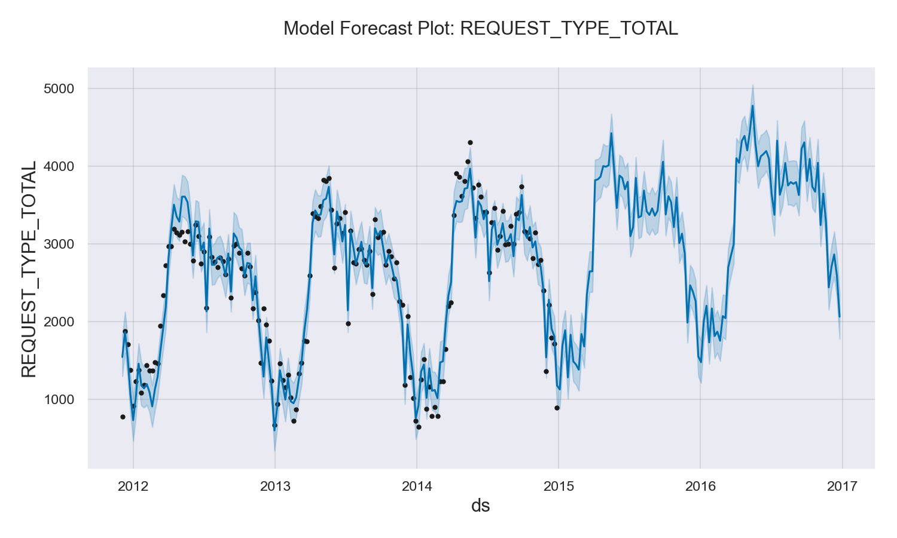
Data Fidelity vs Accuracy: Daily vs Weekly
Prophet’s model fit to the training data is shown for data with daily and weekly frequency
Improved fit and forecast to weekly data is observed; daily data also suffers from undershooting (fixed via value clipping)
Recommend using weekly projections given that external factors may have much bigger impact on daily projections

Slide 16
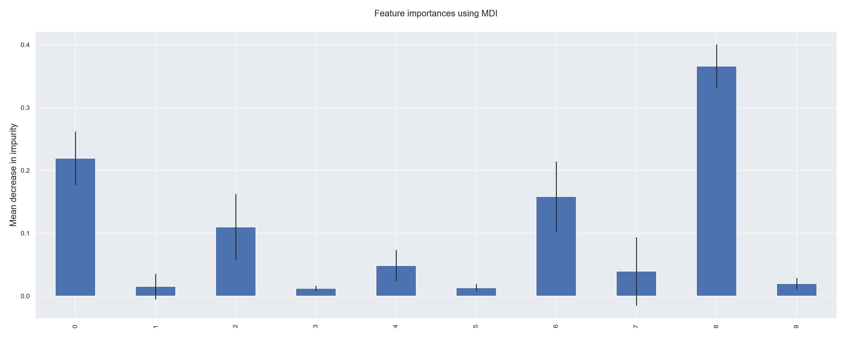
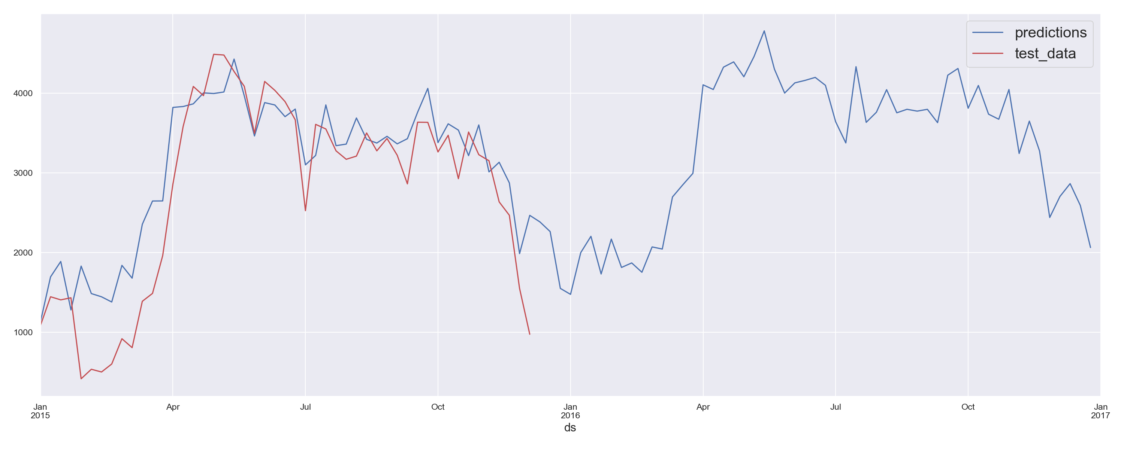
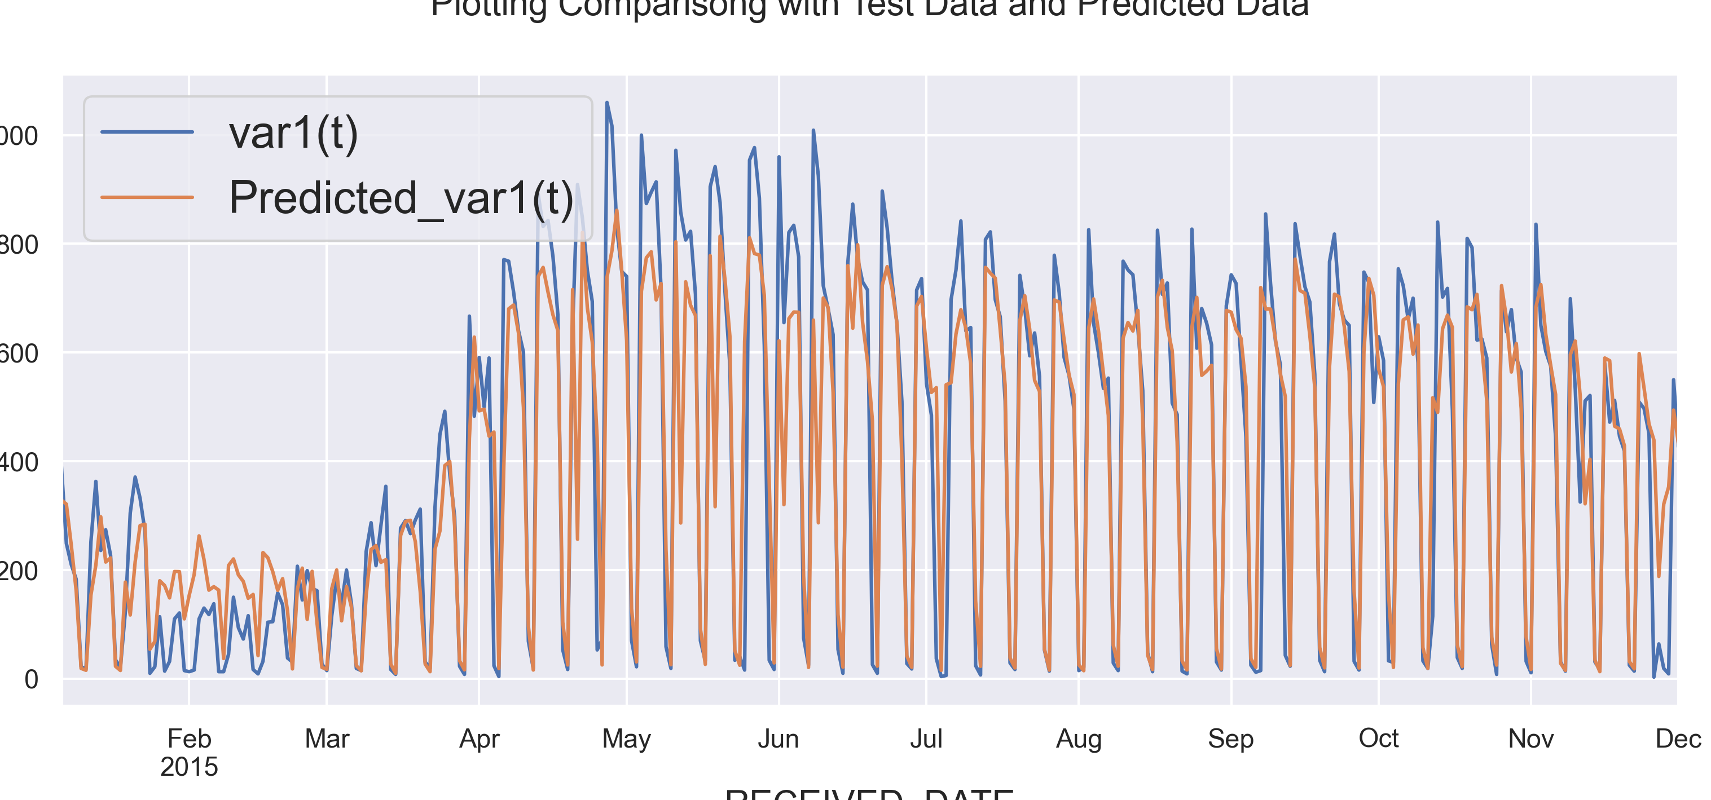
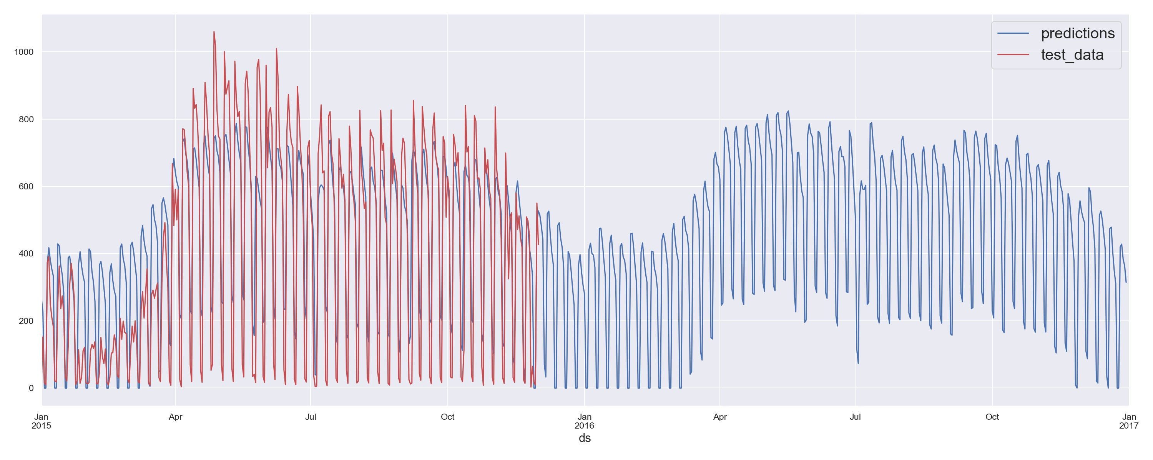
Model Evaluation
Random Forest Feature Importance
Weekly Prophet’s Prediction vs Test Data
Random Forest Prediction vs Test Data
Prophet’s Prediction vs Test Data
Modeling Framework | RMSE/Mean Error | R2 Score
Prophet (Daily) | 3.6 | 0.55
Prophet (Weekly) | 1.84 | 0.6
Random Forest (Daily) | 0.6 | 0.64
Improved prediction to test data observed with RF
RF’s feature importance helps with selecting lag coeff
Lag used for RF is consistent with PACF ~3
Excellent prediction to weekly frequency obtained with Prophet

Slide 17
Summary & Conclusions
Robust OOP Python-based framework implemented to project service call estimations into the future:
Extensible framework encompasses data ingestion, pre-processing, feature engineering, EDA, model development and analysis
Multiple modeling approaches explored with varying degree of success accuracy (both univariate and multivariate forecasting approaches)
Prophet’s prediction with uncertainty band appears to be the most attractive choice – overprint of external influence can be high for daily frequency
Recommendation for data collection along with ideas to extend the work were presented

Slide 18
Backup

Slide 19
Data Ingestion
SQLLite DB ingested as pandas data frame
Simple checks for datatype (integer for service call volumes) along with feature engineering of datetime objects are handled using Pandas methods
No missing information was observed
Request type (string object) converted numerics along with other dataframe reshaping and merging operations
DatetimeIndex: 529769 entries, 2011-12-01 06:12:00 to 2015-12-01 15:03:00
Data columns (total 12 columns):
# Column Non-Null Count Dtype
--- ------ -------------- -----
0 RECEIVED_DATE 529769 non-null datetime64[ns]
1 RECEIVED_TIME 529769 non-null timedelta64[ns]
2 REQUEST_TYPE 529769 non-null object
3 TOWN_NAME 529769 non-null object
4 YEAR 529769 non-null int64
5 MONTH 529769 non-null int64
6 WEEK 529769 non-null int64
7 DAYS 529769 non-null int64
8 REQUEST_TYPE_E 529769 non-null int64
9 REQUEST_TYPE_N 529769 non-null int64
10 REQUEST_TYPE_TOTAL 529769 non-null int64
11 REQUEST_ET_RATIO 529769 non-null float64
dtypes: datetime64[ns](1), float64(1), int64(7), object(2), timedelta64[ns](1)
memory usage: 52.5+ MB

Slide 20
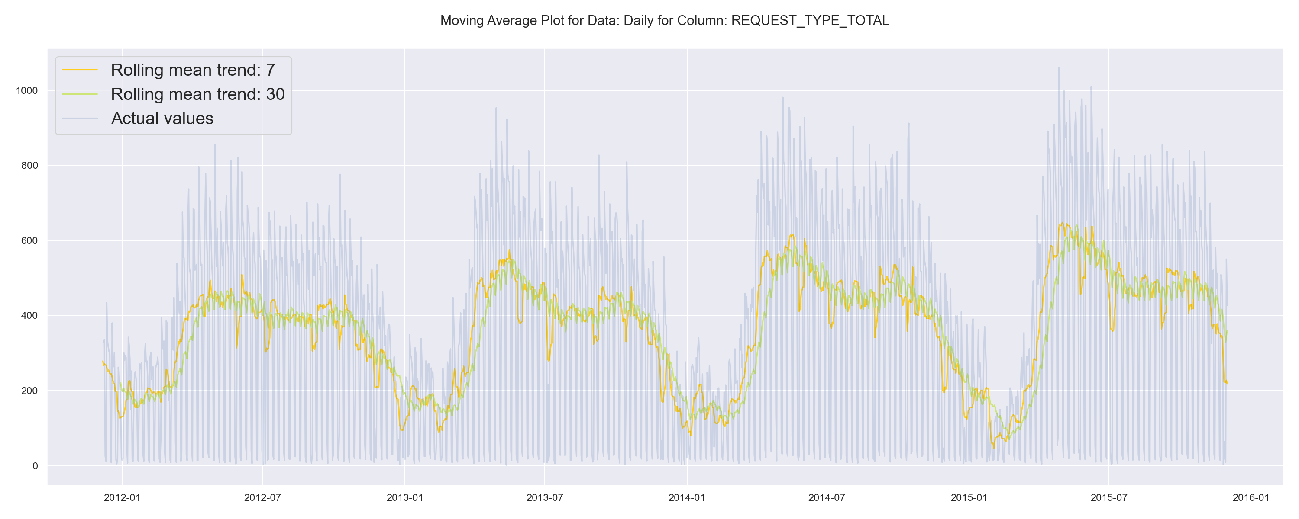

Slide 21
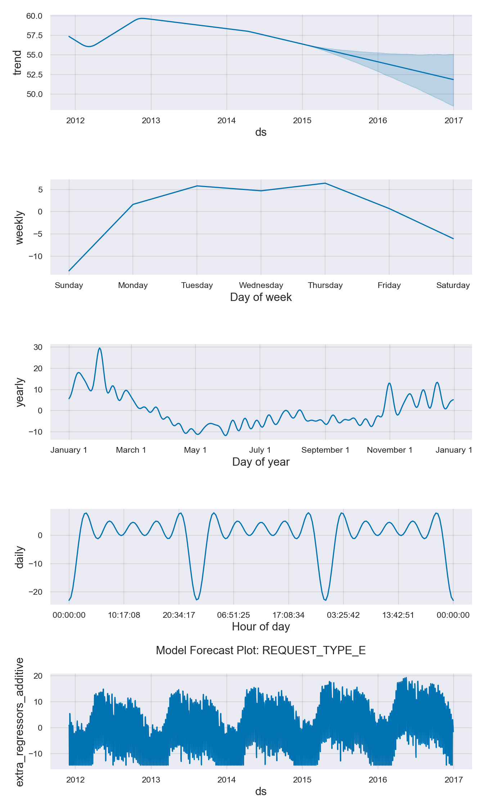
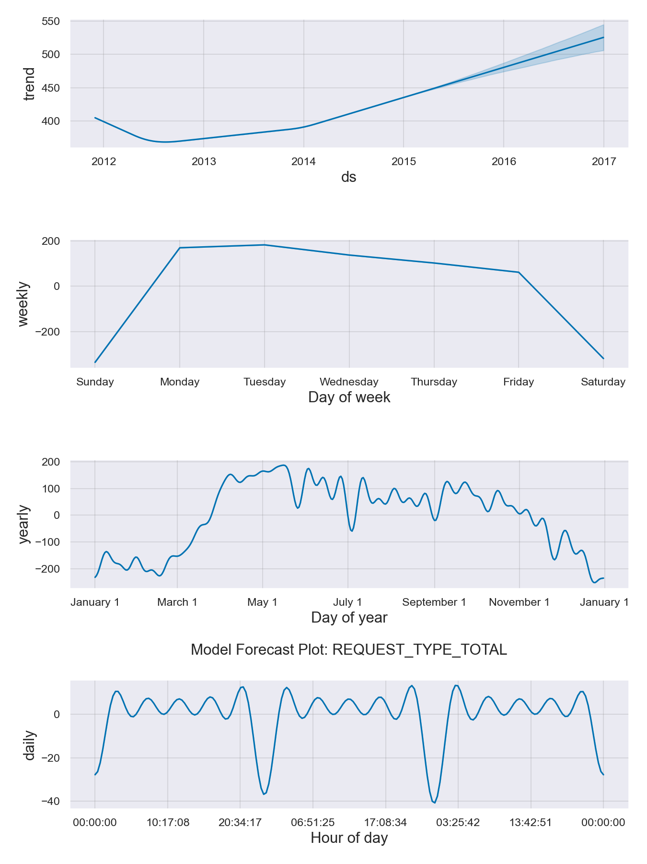

Slide 22
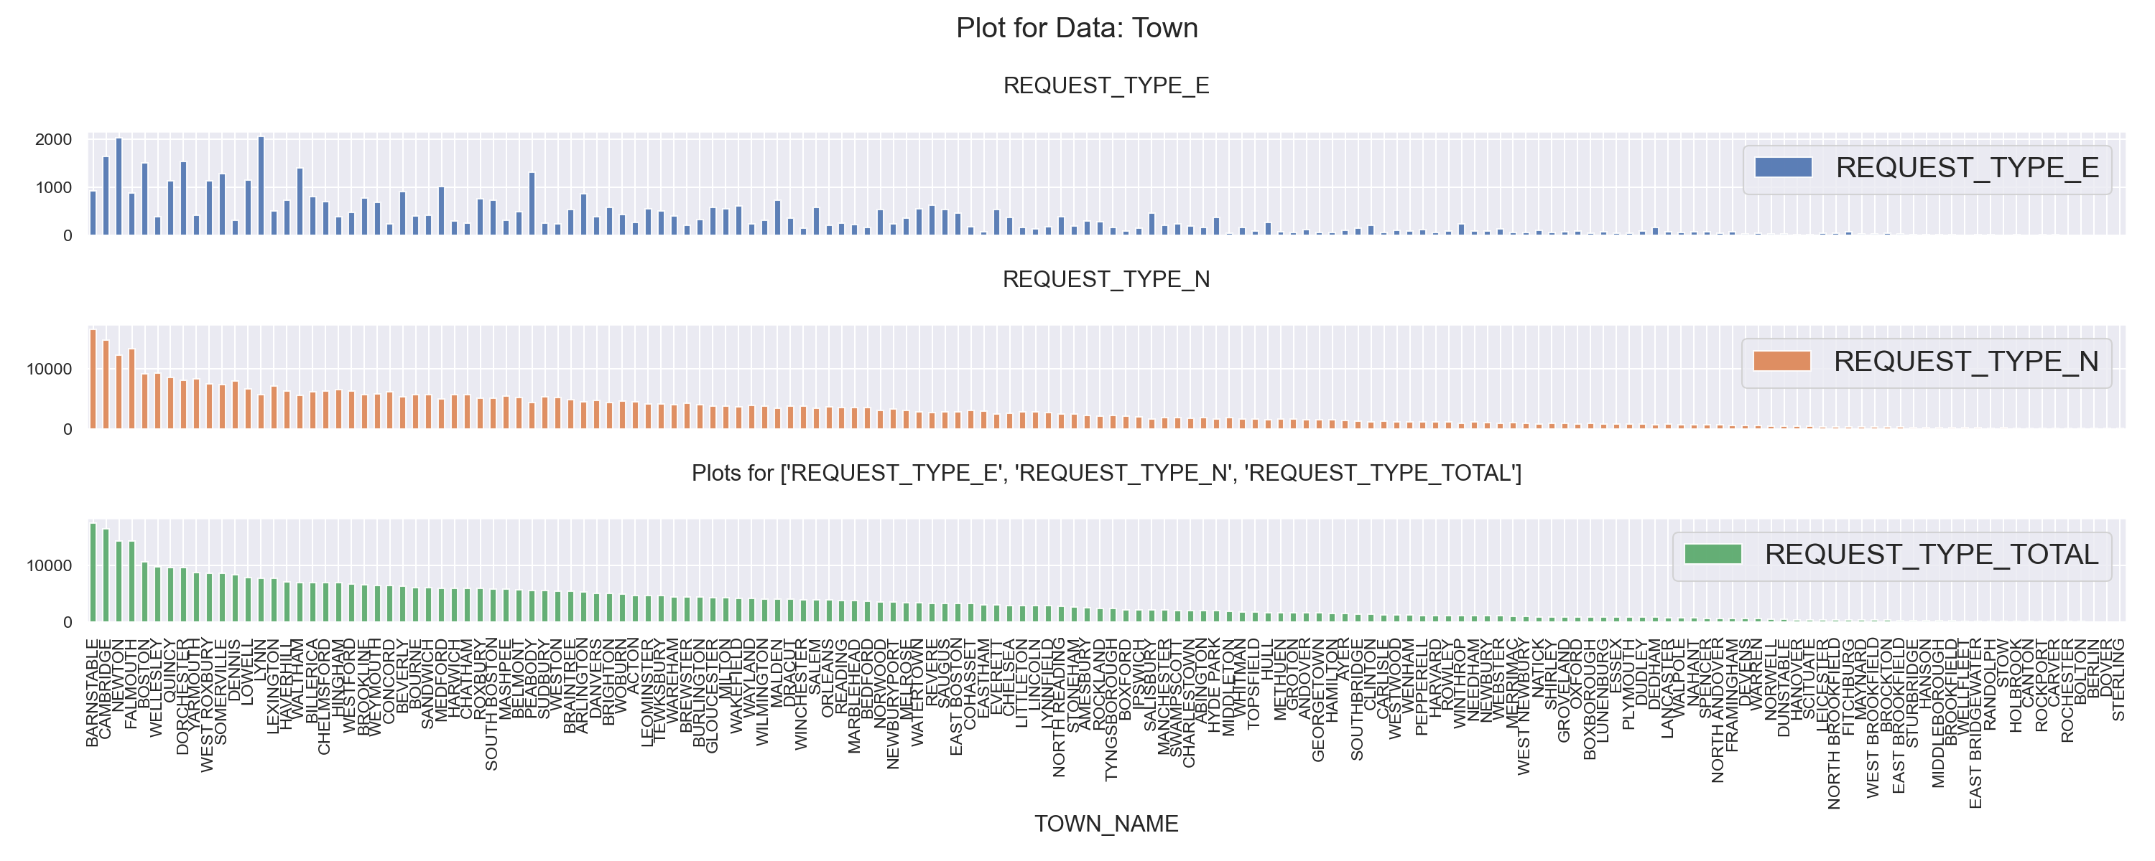

Slide 23
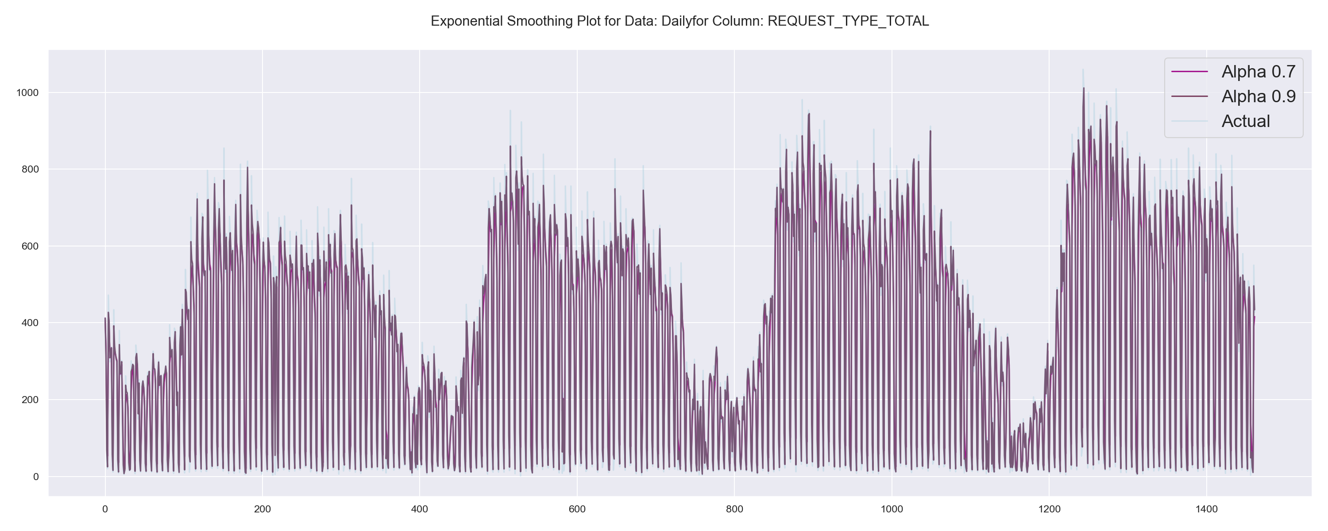

Slide 24
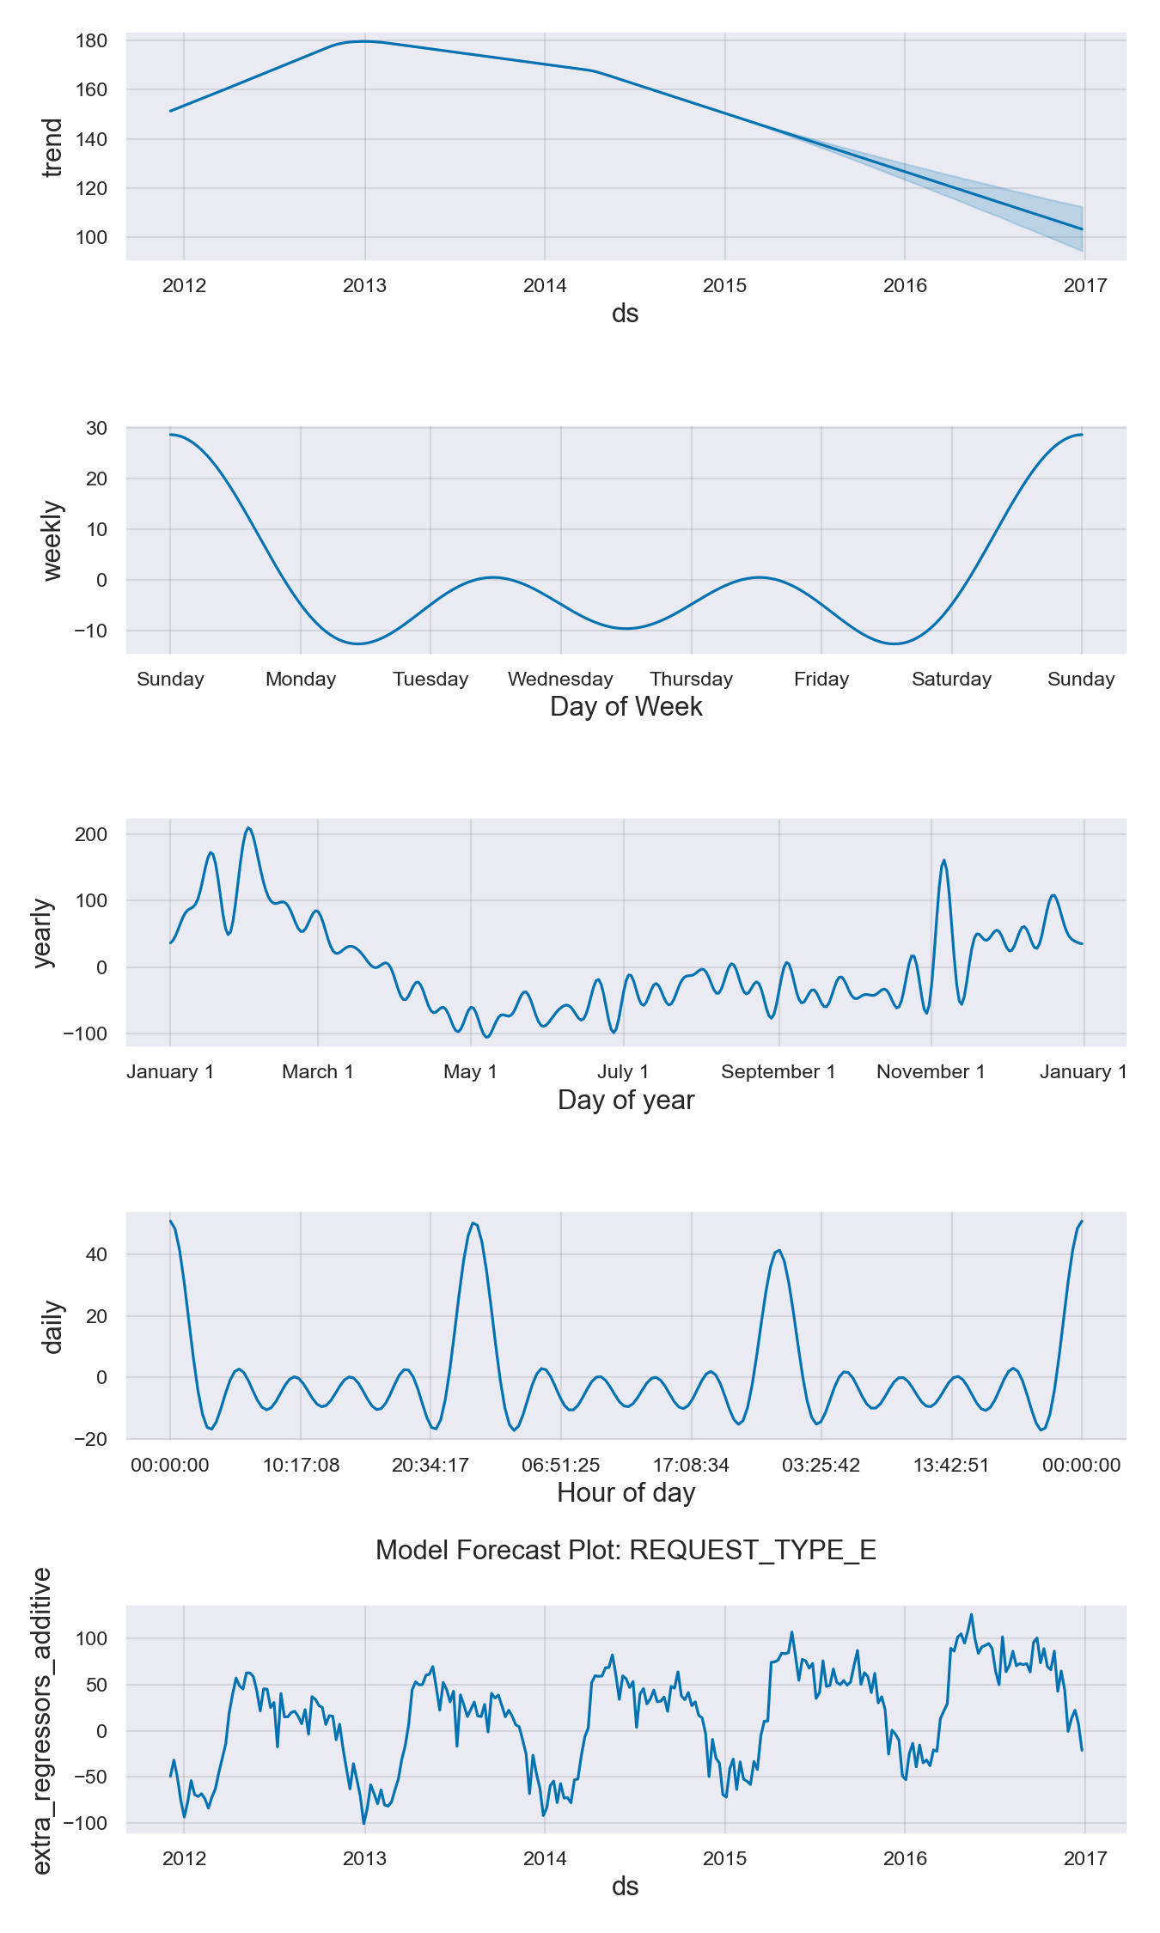
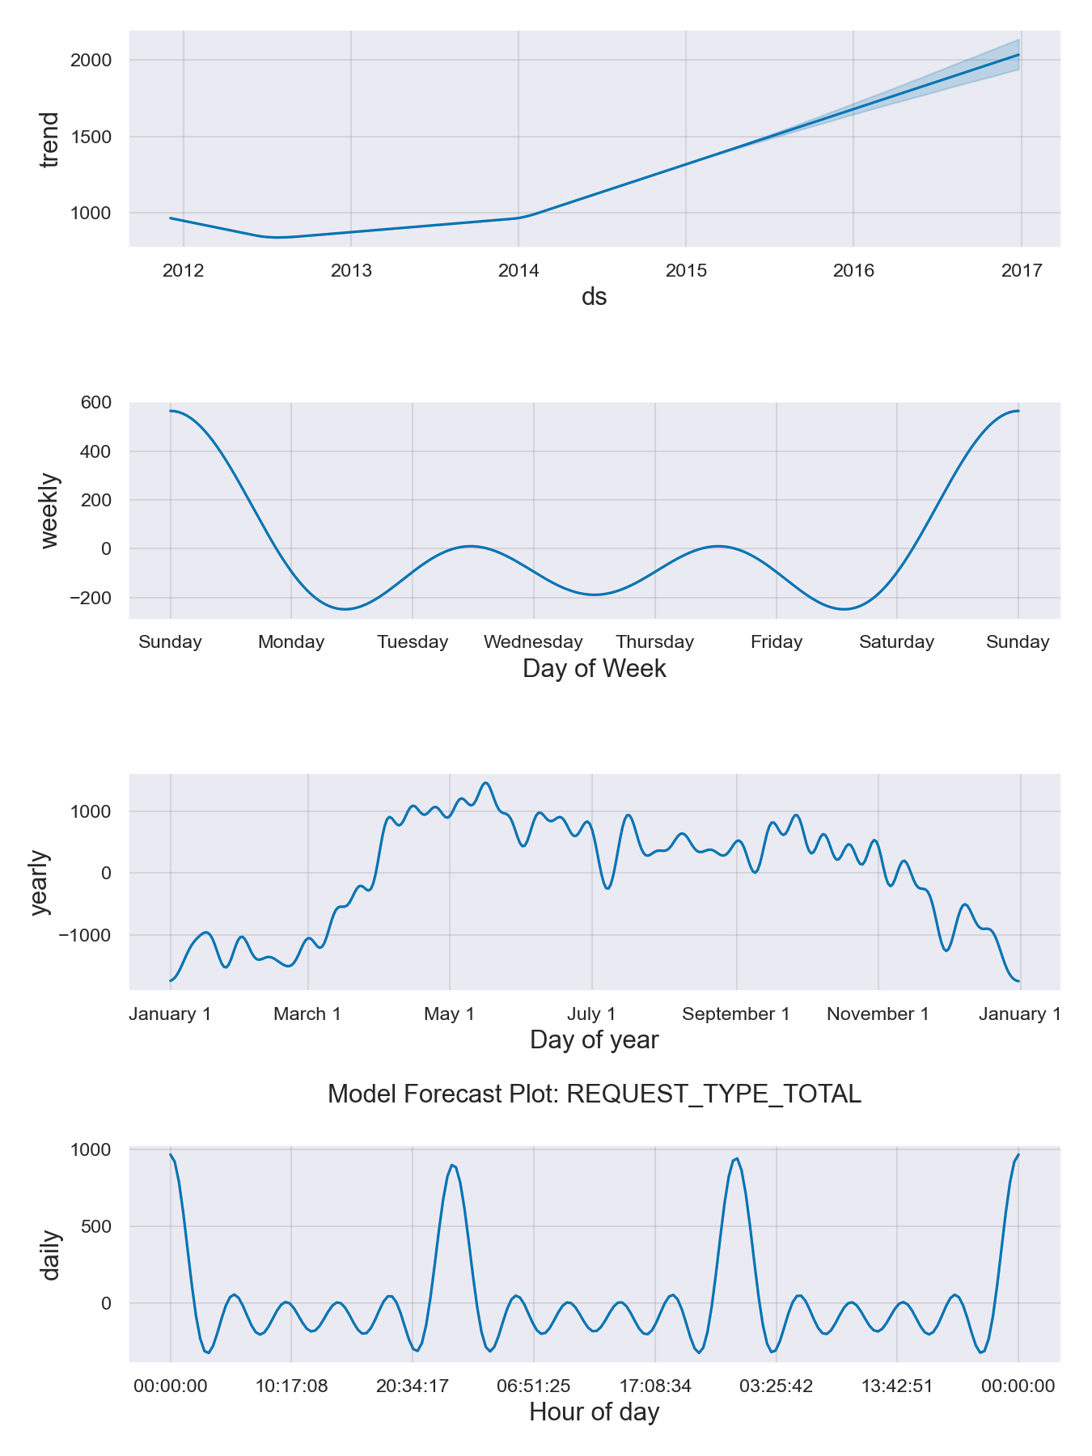
Model Components

